Slide 1
Lecture Notes: Reduction of Uncorrelated Noise

Slide 2
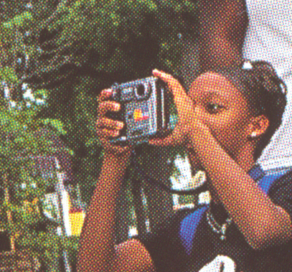
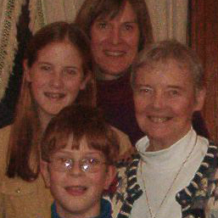
Noise in Images
All images created through optical projection onto a sensor array are noisy.
Correlated noise
Due to electrical interference
Due to source / sensor interference
Halftone distortion / moiré patterns
Uncorrelated noise
Quantum noise in CCD arrays
Silver halide grains in film photography
Neuronal noise in a retina
Quantization noise in digital photographs

Slide 3
Image with Additive Noise
noisy image
additive noise
noisy image
additive noise
undegraded image
undegraded image
spatial domain
frequency domain

Slide 4
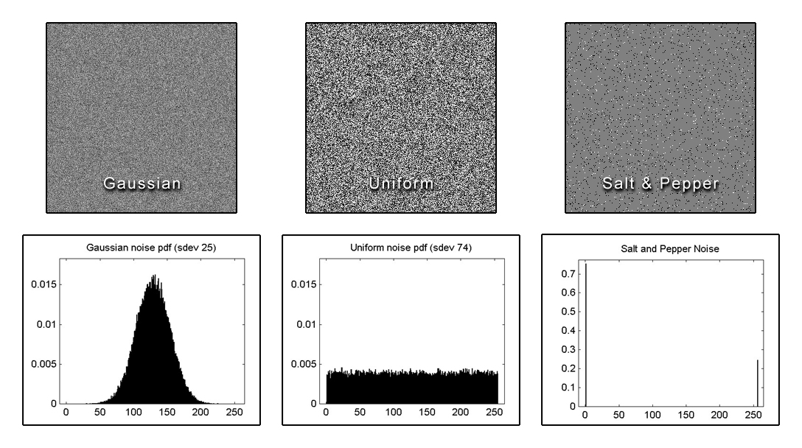
Uncorrelated Noise
Intensity distributions – normalized histograms
Each pixel’s value has probability of occurrence given by the associated distribution.

Slide 5
Uncorrelated Noise
Intensity distributions – normalized histograms
The most likely value is 128 with an average difference of 25 from 128 (std. dev.).
This is sparse noise: Only 12.5% of the pixels contain noise. Of those 12.5% …
All values occur with equal probability.
… black pixels occur 75% of the time and
white pixels occur 25% of the time.
Each pixel’s value has probability of occurrence given by the associated distribution.

Slide 6
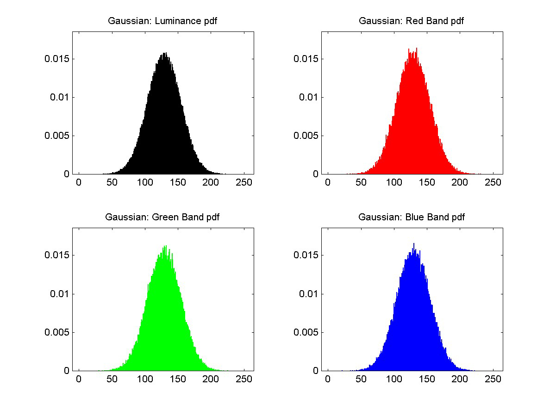

Uncorrelated Color Noise: Gaussian

Slide 7
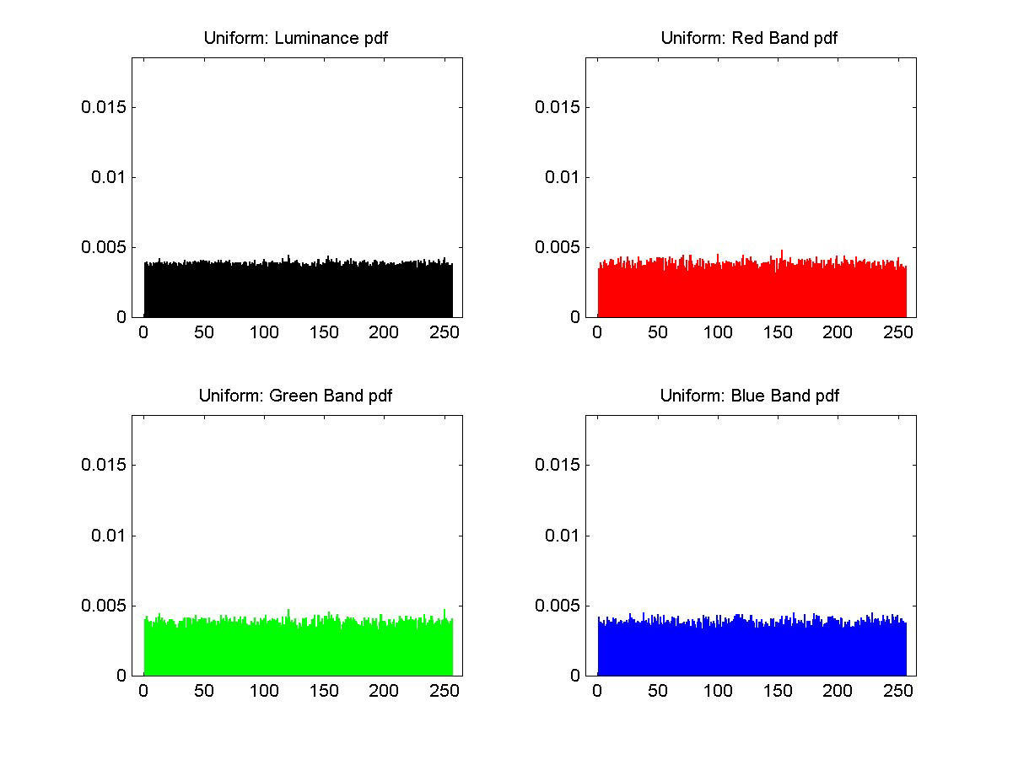

Uncorrelated Color Noise: Uniform

Slide 8
Noise Enhancement: Problem with Sharpening
Noise occurs in every natural imaging device
Quantum effects in CCD arrays
Random distribution of silver halide grains in film
Neuronal noise in the retina
Spatially independent noise
The noise in one sensor has no effect on that in its neighbors
⇒ the autocorrelation of the signal is an impulse at the origin
The chances of getting repeated patterns of any frequency are virtually nil
⇒ the frequency spectrum of the noise is flat
Recall: Autocorrelation = inverse Fourier transform of power spectrum; Fourier transform of an impulse at (0,0) is a constant.

Slide 9
Noise Enhancement: Problem with Sharpening
The spectra of most natural images fall-off toward the high frequencies.
IID noise has a flat spectrum.
Therefore, at some relatively high frequency (HF) the energy in the noise is greater than that in the uncorrupted image.
Sharpening multiplies the FT of the image by u and v (or by linear combinations of them) which, at HF, increases the noise more than the uncorrupted image.

Slide 10
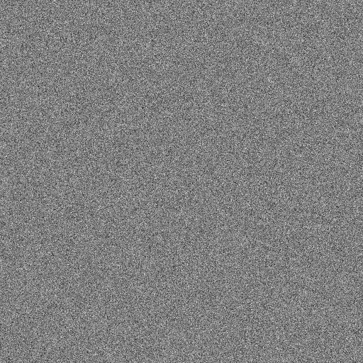
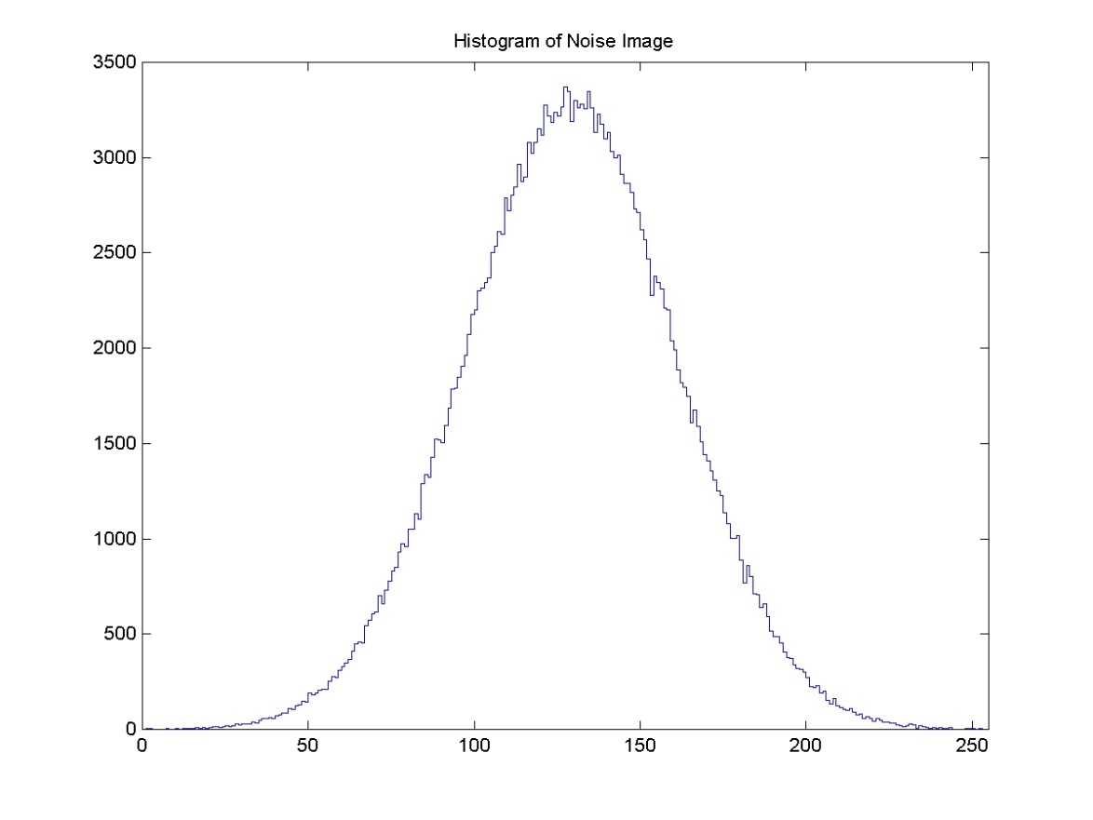
Gaussian IID Noise Field
IID ⇒ no spatial correlation
μ = 128
σ = 32
IID: Independent, Identically Distributed

Slide 11
Gaussian IID Noise Field
IID ⇒ no spatial correlation
μ = 128
σ = 32
2
… is this number divided by the number of pixels in the image.
The probability of any one pixel having this value …
1
IID: Independent, Identically Distributed

Slide 12
Autocorrelation of an Image
Let the support of I be a torus. (I is defined on a torus a la the Fourier transform.)
Let be I minus the mean value of I. Make a copy of . Shift the copy by (ρ,χ) on the torus. Pixel-wise multiply the shifted version by the original and sum the products.
A_{I}(ρ,χ), the autocorrelation of I at offset (ρ,χ), is a measure of the similarity of I to itself when shifted by (ρ,χ).

Slide 13
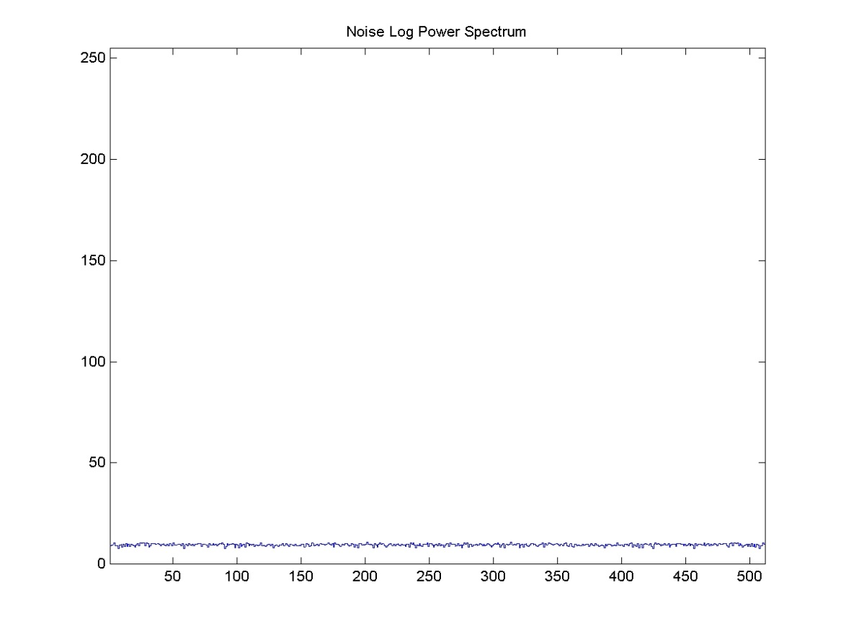
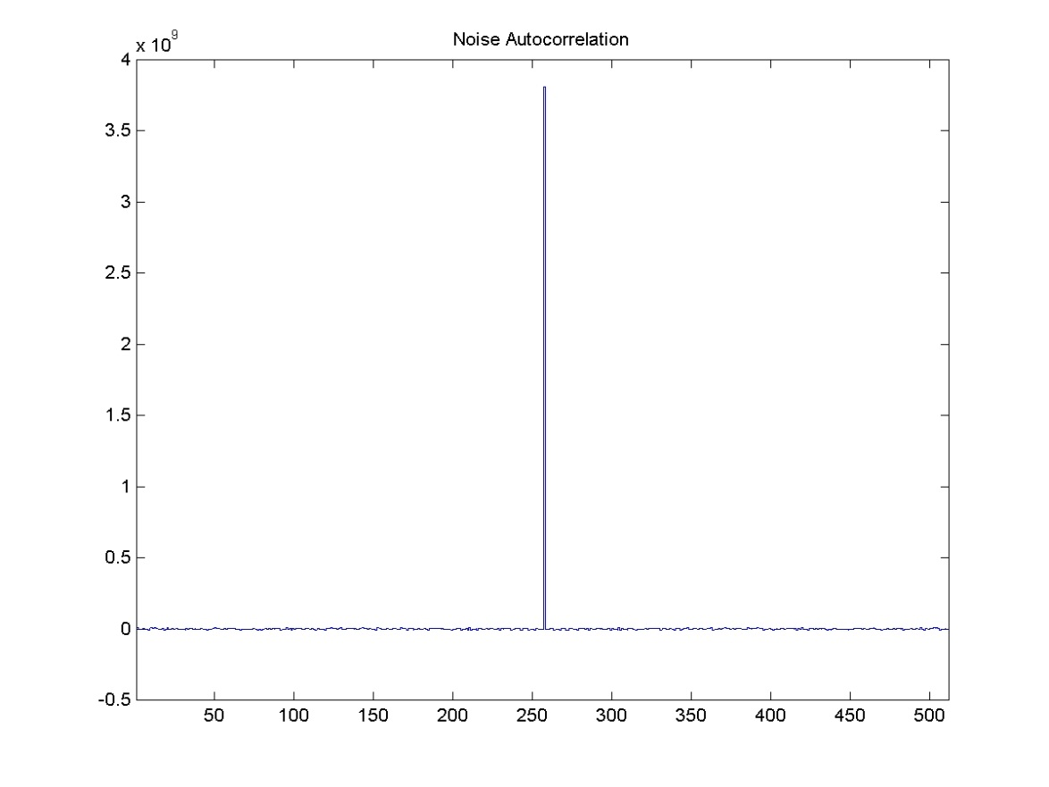
Power Spectrum & Autocorrelation of IID Noise
Power Spectrum
Autocorrelation
ρ = 0
The autocorrelation is the inverse FT of the power spectrum.
χ
-C/2
0
C/2

Slide 14
Power Spectrum & Autocorrelation of IID Noise
Power Spectrum
Autocorrelation
ρ = 0
The autocorrelation of an IID noise image is ≈ δ(ρ,χ). That implies the PS is ≈ constant
χ
-C/2
0
C/2

Slide 15


Noise-Free Image and Uncorrelated Noise Field
image
Gaussian noise field

Slide 16
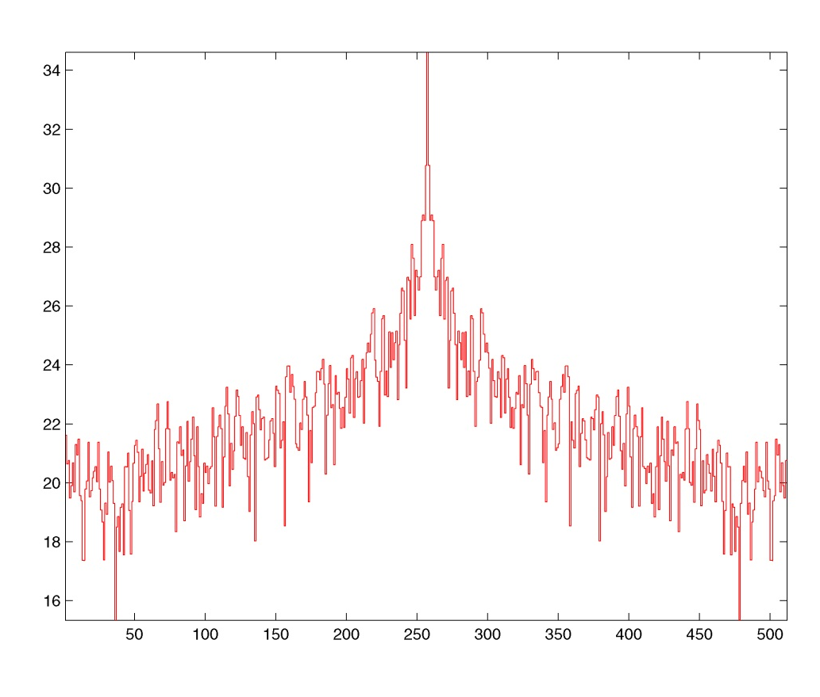
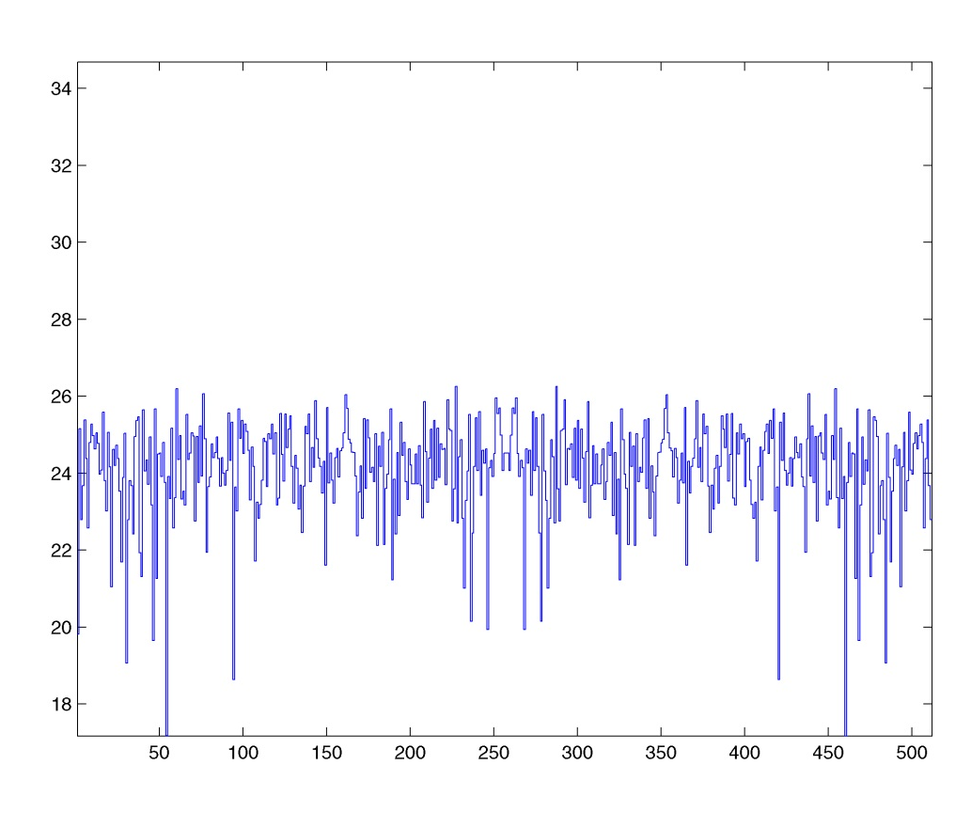
Spectra of Noise-Free Image and Uncorr. Noise Field
Image spectrum falls off.
IID noise spectrum is flat.
image center row log power spectrum
noise field center row log power spectrum

Slide 17

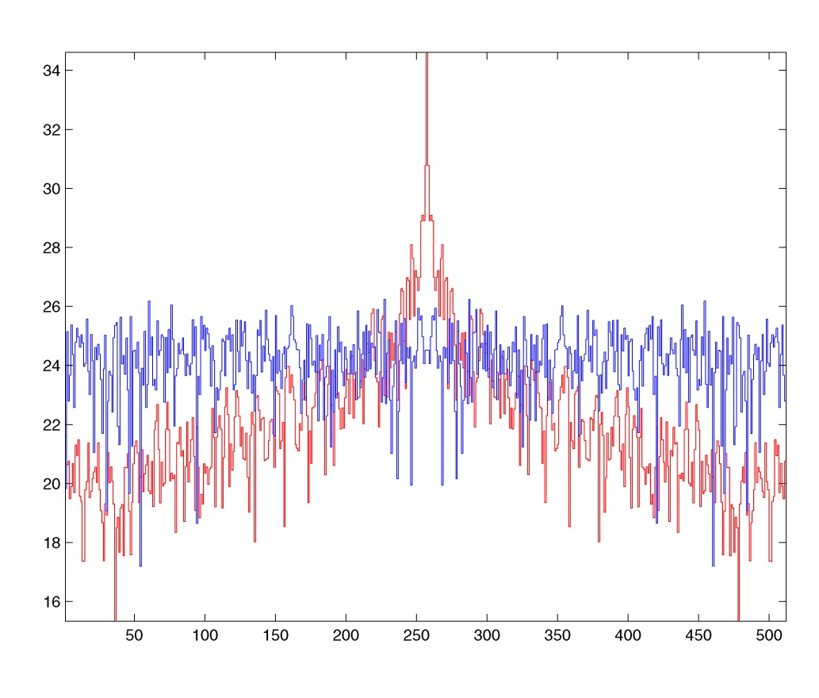
Sum of Noise-Free Image and Uncorrelated Noise Field
Noise energy exceeds image energy beyond a certain freq.
image + noise field
image + noise field center row log PS

Slide 18
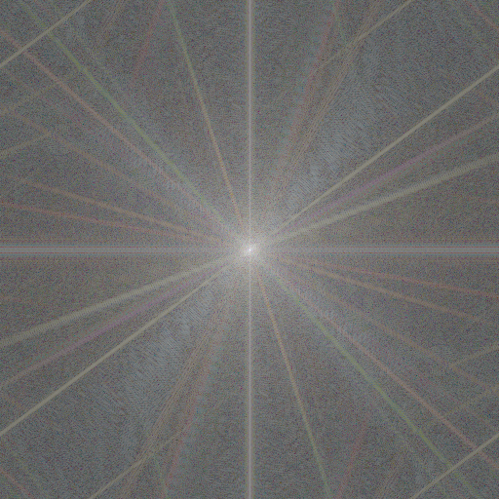

Power Spectra of Noise-Free Image and Noise Field
original image
noise image

Slide 19

Power Spectra of Sum of Image and Noise Field
original image
noisy image

Slide 20
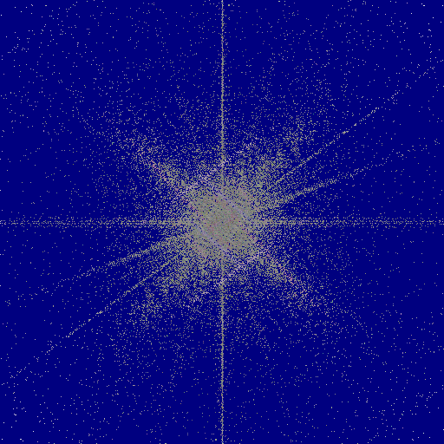
Power Spectra of Sum of Image and Noise Field
original image
blue indicates noise > image

Slide 21
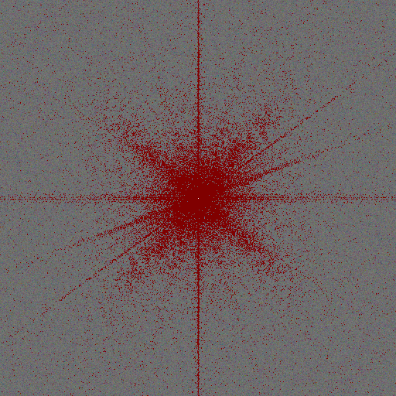
Power Spectra of Sum of Image and Noise Field
noise image
red indicates image > noise

Slide 22
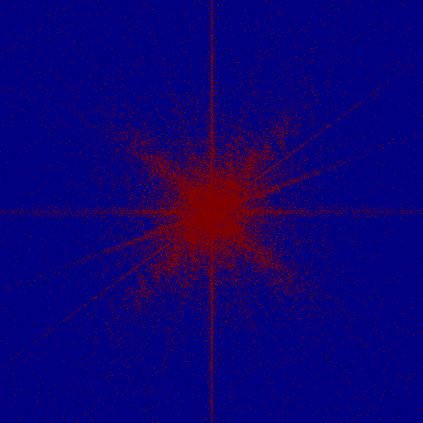
Power Spectra of Sum of Image and Noise Field
noisy image
image & noise

Slide 23
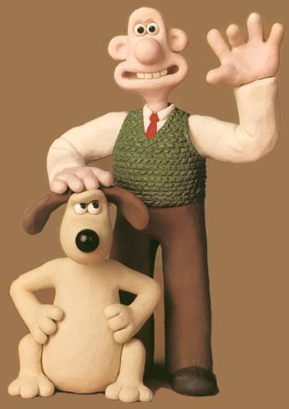

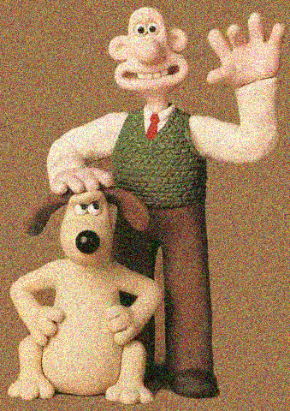
Additive Noise: Another Example
original image
noise image
image+noise

Slide 24
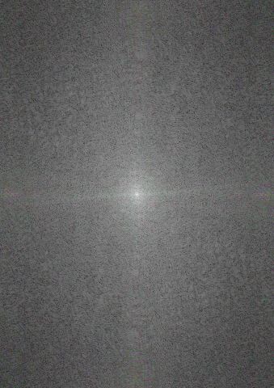

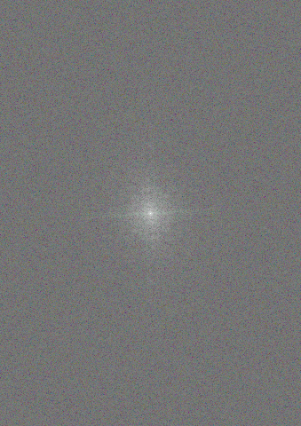
Additive Noise: Another Example
displayed:
image PS
noise PS
image+noise PS

Slide 25
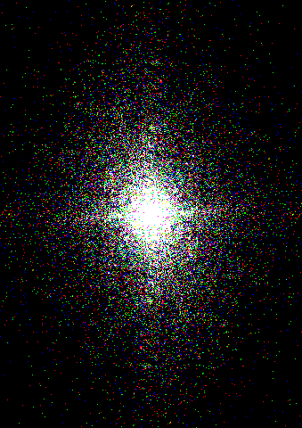
Additive Noise: Another Example
displayed:
image PS
image+noise PS
image PS > noise PS

Slide 26
Additive Noise: Reduce Through Blurring?
At some frequency, f₀, there are more components where the noise power is greater than the image power.
f₀
f₀
red indicates image > noise
image PS > noise PS

Slide 27
Additive Noise: Reduce Through Blurring?
Thus, it makes sense to apply a LPF with cutoff f0, (a blurring filter) to the images and see what happens.
pass
pass
reject
reject
red indicates image > noise
image PS > noise PS

Slide 28
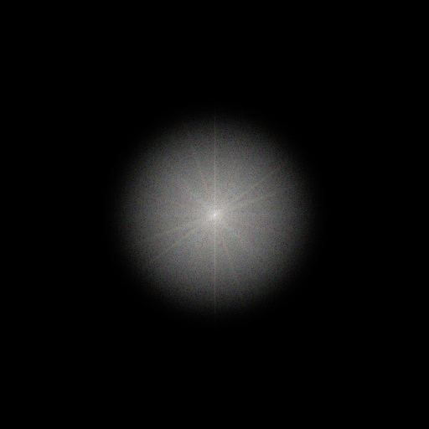

Additive Noise: Reduction Through Blurring.
The result is actually no better. There’s less noise but the blurring looks worse.
PS of Gaussian blurred image
Gaussian Blurred Image

Slide 29
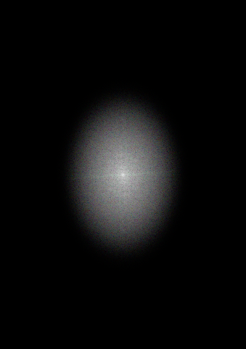
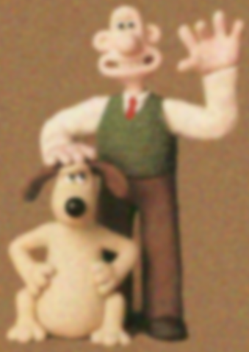
Additive Noise: Reduction Through Blurring.
The result is actually no better. There’s less noise but the blurring looks worse.
PS of Gaussian blurred image
Gaussian Blurred Image

Slide 30
Noise Masking
If the freq. comps. for which noise-power > image-power are known¹…
red: image > noise
blue: image < noise
power spec. of noisy image
¹of course they almost never are.

Slide 31
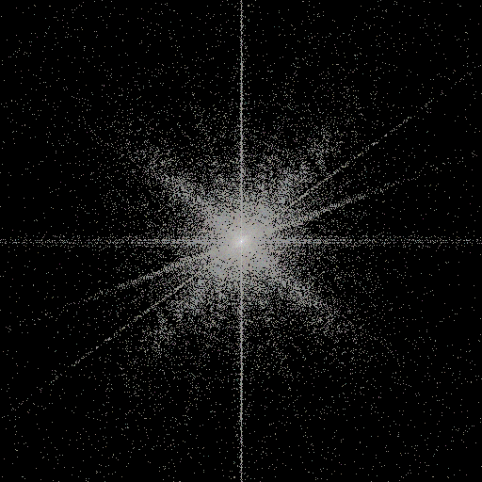
Noise Masking
… mask those out of the FT and invert the result to get…
power spec. of noisy image
image < noise masked out

Slide 32
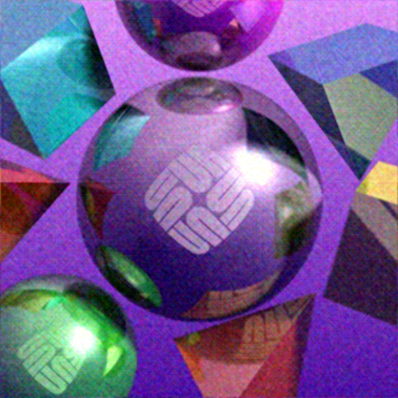
Noise Masking
… this:
noisy image
noise-masked mage

Slide 33
Noise Masking
Although the noise-masked image looks better than the blurred one, it is still noisy. Moreover, this example is unrealistic because we know the exact noise power spectrum. In any real case we will at most know its statistics.
blurred noisy image
noise-masked mage

Slide 34
Image Degradation Model
So far, we have considered only additive noise. Before going further it will be useful to consider a more general model of image degradation, one that includes convolution with a pointspread¹ function, H, as well as additive noise.
degraded image
pointspread function
undegraded image
additive noise
¹H is also referred to as the optical transfer function.

Slide 35
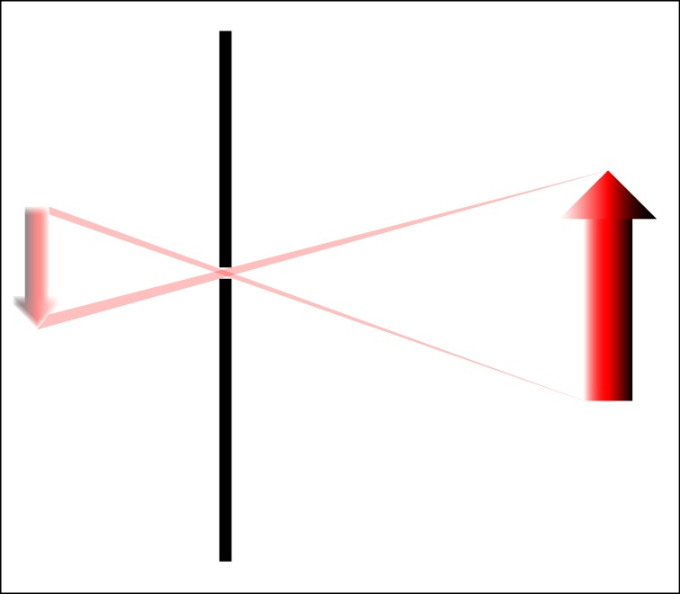
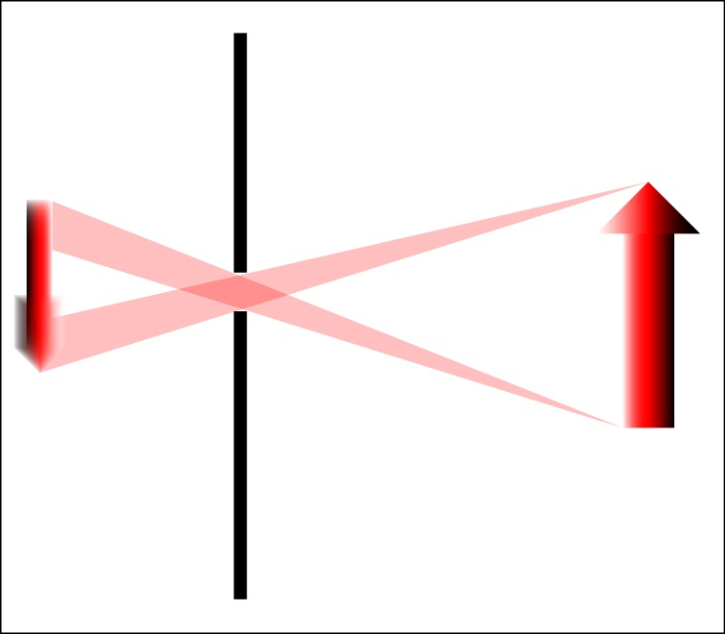
Pointspread Operators
A pointspread operator is a linear model of the distortion acquired during the imaging process. Since it is a linear model, it is a convolution operator. One example of this is aperture distortion, an unavoidable consequence of making an image with a camera that has an opening larger than a point.

Slide 36
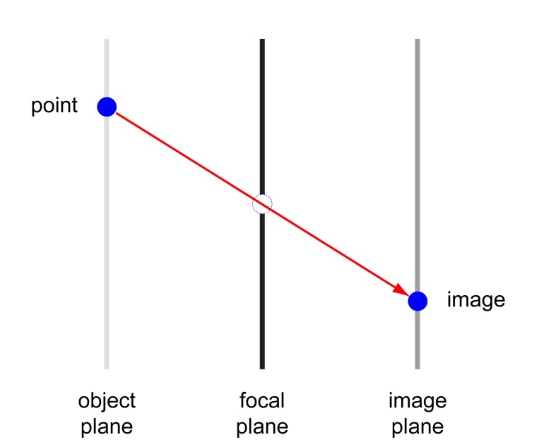
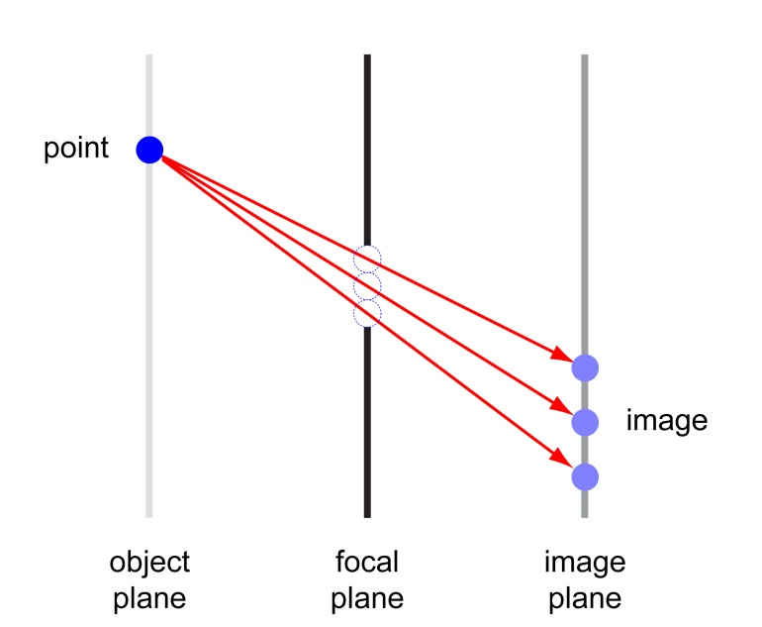
Pointspread Operators
pinhole camera
aperture camera
A pinhole camera maps one object point to one image point; it is one-to-one.
An aperture camera maps one object point to many image points; it spreads the points.

Slide 37
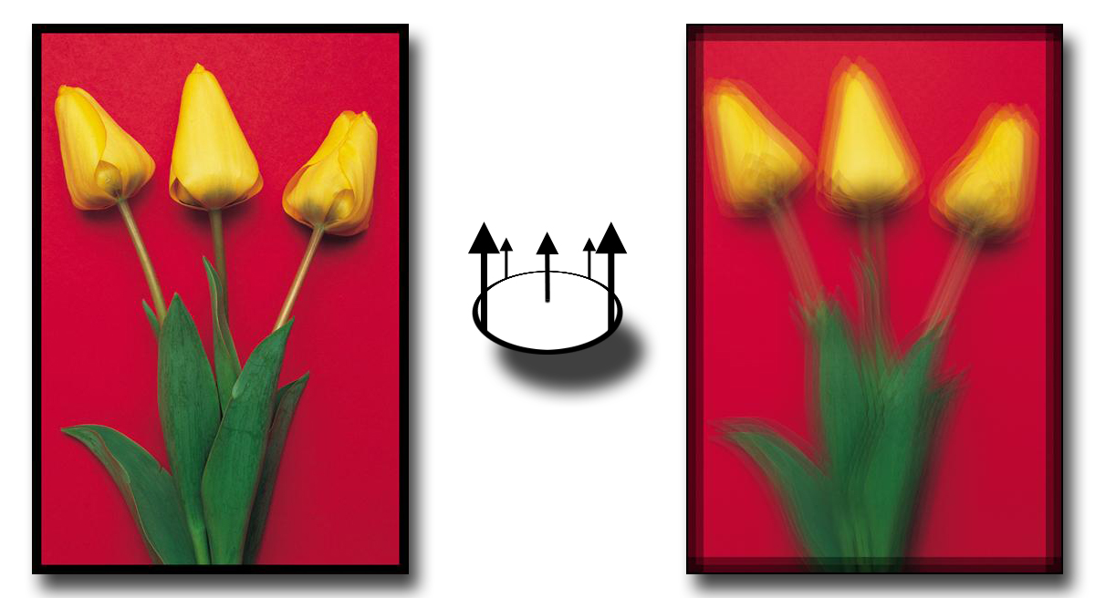
Pointspread Operators and Convolution
Recall how a convolution works through multiply, shift, and add (See Lect. 7 p. 25ff). That is precisely the effect of imaging through an aperture. It results in a blurry image.

Slide 38
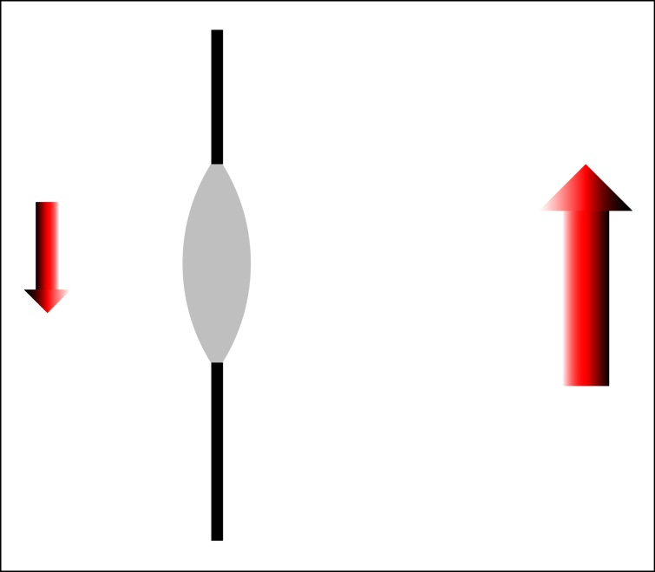
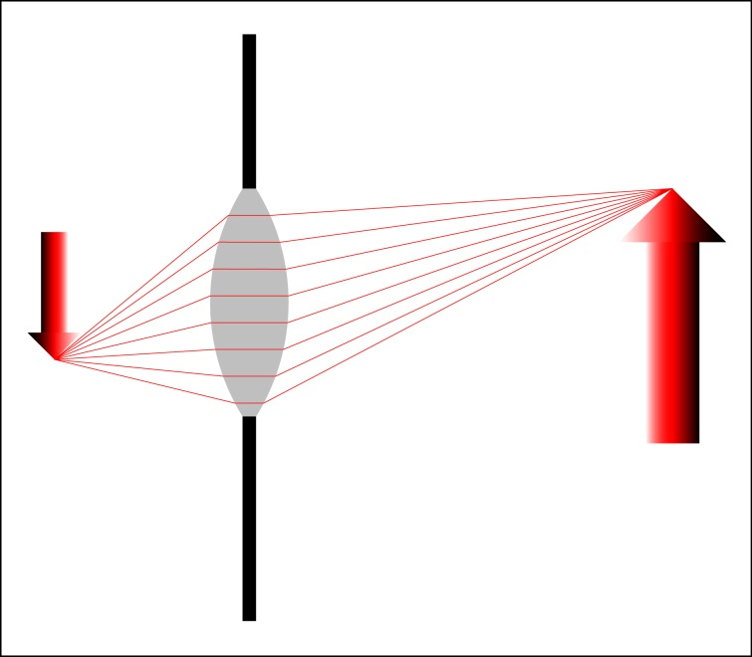
Lenses
A properly designed lens will focus the light emanating from a point and thereby reduce the blurring. But no lens can do this perfectly. In fact, the lens adds its own distortion. The result is an optical transfer function, H(r,c), that is convolved with the image.

Slide 39
Image Degradation Model
degraded image
pointspread function
undegraded image
additive noise
Note: The term pointspread operator refers to convolution by the pointspread function.

Slide 40
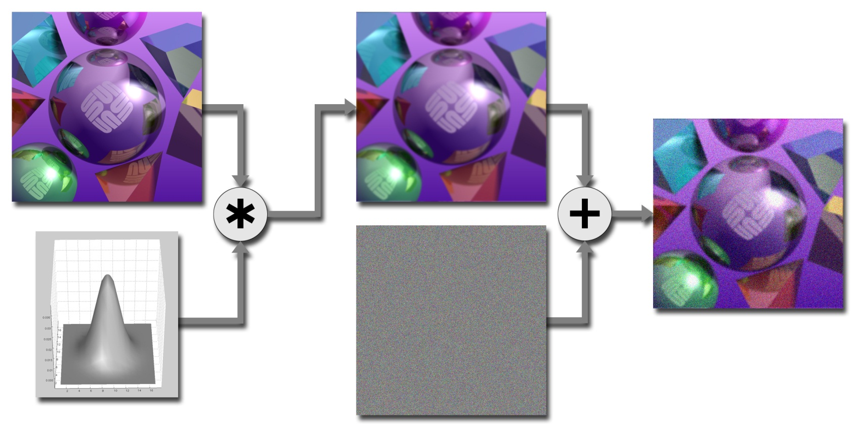
Image Degradation Model

Slide 41
Image Degradation Model (Frequency Domain)
degraded image
pointspread operator
undegraded image
additive noise

Slide 42
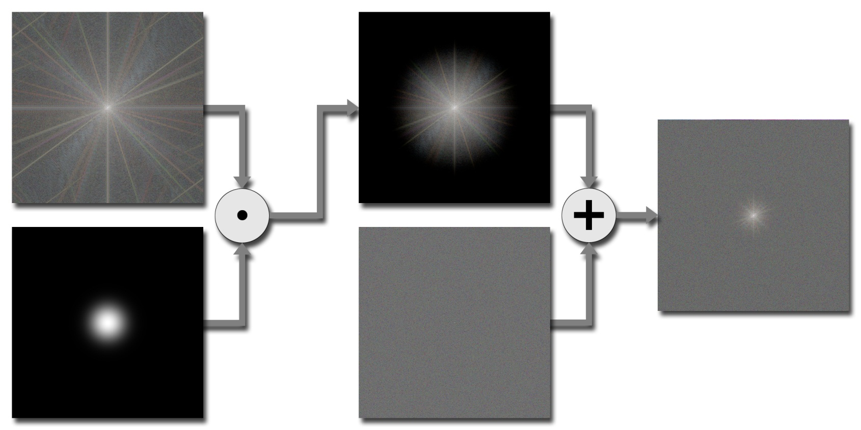
Image Degradation Model (Frequency Domain)
Images shown are log magnitude.

Slide 43
Image Restoration
Let I be a perfect image and let K be the image convolved with a pointspread function, H. Then in the frequency domain:
Then an estimate of I would be the inverse Fourier transform of
We want to find the filter, W, that results in the closest possible estimate of I i.e. the W that minimizes the energy of the difference between the estimate and I.
That is we want to find W such that
If the process of imaging adds noise then we get J = K + N, or in freq.:
We want a filter, W, to remove as much of the noise from J as possible:
is as small as possible. This is called least mean squared (LMS) minimization.

Slide 44
Image Restoration
There are a number of ways to solve for the minimum squared error. All make use of the assumption that the image and the noise are uncorrelated. Depending on how that fact is used, slightly different solutions are found. The most common one used in image processing is the Wiener filter:
For frequencies (u,v) where noise power is smaller than the image power W acts like an inverse filter since N(u,v)/I(u,v) < 1 and
and at frequencies where the noise power dominates, N(u,v)/I(u,v) > 1 and
Then, with a little bit of algebra, we get
the fraction is small so the noise power is diminished.

Slide 45
Image Restoration
This is one of the possible derivations of the Wiener filter

Slide 46
Image Restoration
From the previous page, the squared error is
The second term should be small compared to the first since it can be written
and the image and the noise are assumed to be uncorrelated¹. Thus the error can be approximated by
The mean squared error, ε², is minimized when W is given by,

Slide 47
Noise Reduction Through LMS Filtering¹
image
Gaussian noise field
¹Here the PSF is the identity.

Slide 48
Noise Reduction Through LMS Filtering¹
image
noisy image
¹Here the PSF is the identity.

Slide 49
Additive Noise (Power Spectra)
original image
noisy image

Slide 50
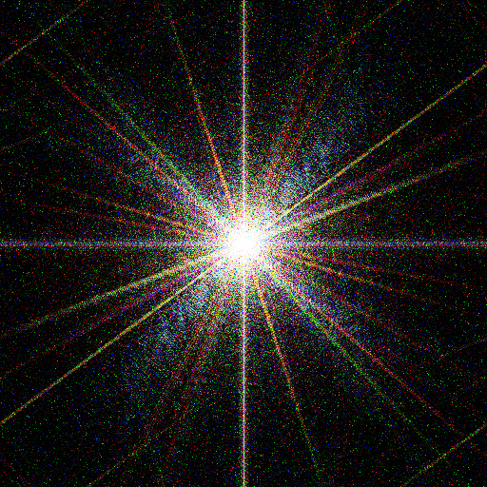
Additive Noise (Power Spectra)
In this example we knew the exact image and noise power spectra and the PSF was the identity because the image is synthetic. In a real example, none of that is true.
noisy image
Wiener filter

Slide 51
Additive Noise (Power Spectra)
noisy image
Wiener filter

Slide 52
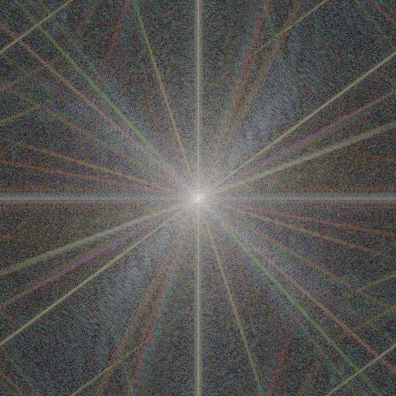
Additive Noise (Power Spectra)
Wiener filtered image
original image

Slide 53
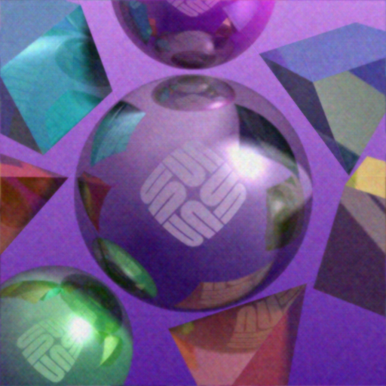
Additive Noise
noisy image
Wiener filtered image

Slide 54
Additive Noise
Wiener filtered image
original image

Slide 55
Additive Noise
Gaussian blurred image
original image

Slide 56
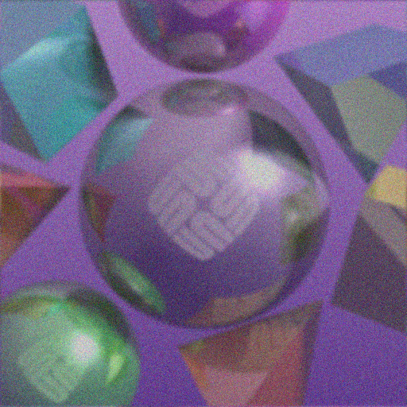
Noise Reduction Through LMS Filtering¹
image
noisy image J = I*h + N
¹Least Mean Squared. PSF, h, is Gaussian μ=0, σ=2.

Slide 57

Image*PSF + Noise (Power Spectra)
original image
noisy image J = I*h + N

Slide 58
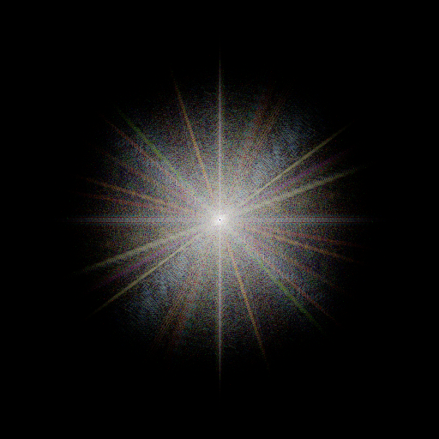
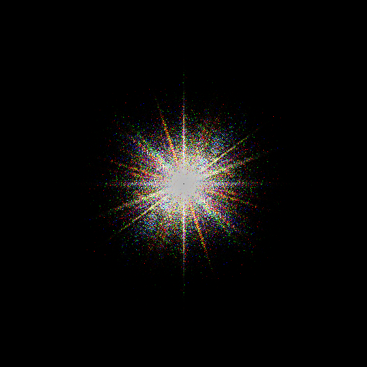
Image*PSF + Noise (Power Spectra)
In this example we knew the exact image and noise power spectra and the PSF was Gaussian w/ μ=0, σ=2. In a real example, none of that is true.
Wiener filtered image
Wiener filter

Slide 59
Image*PSF + Noise (Power Spectra)
Wiener filtered image
Wiener filter

Slide 60
Image*PSF + Noise (Power Spectra)
Wiener filtered image
original image

Slide 61

Image*PSF + Noise
noisy image J = I*h + N
Wiener filtered image

Slide 62
Image*PSF + Noise
Wiener filtered image
original image

Slide 63
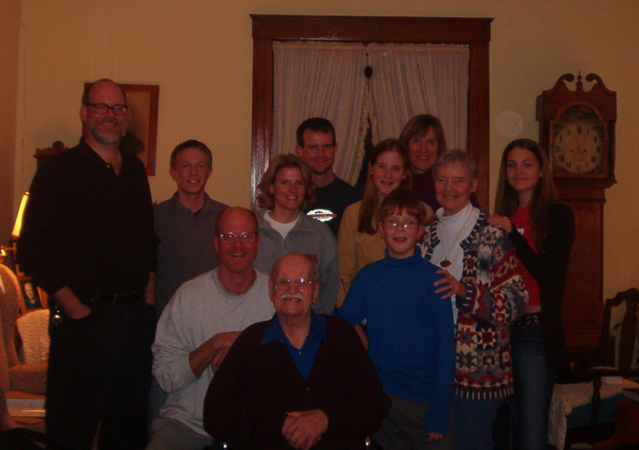
LMS Image Restoration (Real Example)
For this real example we need to estimate the image power spectrum, the pointspread function and the noise power spectrum.

Slide 64
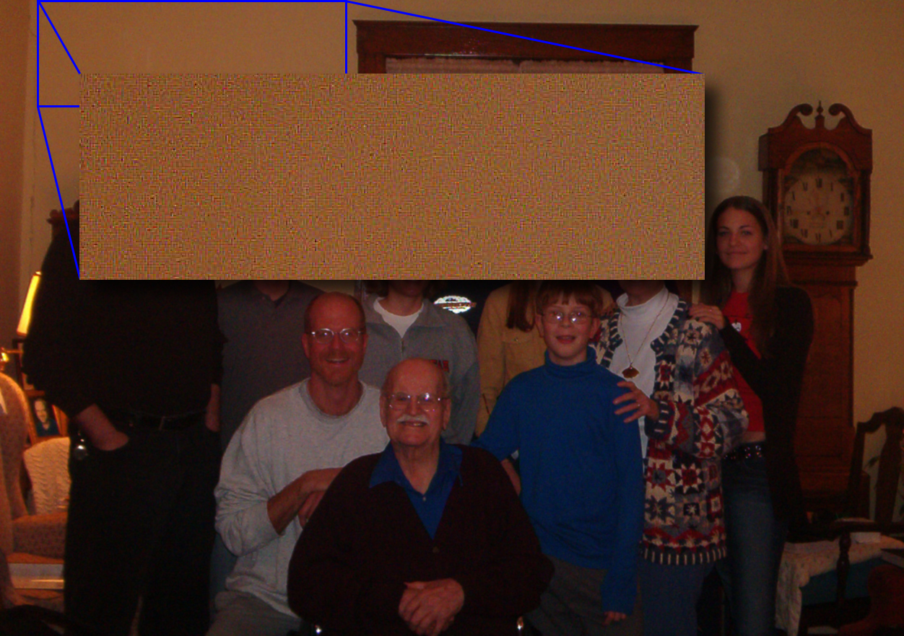
LMS Image Restoration (Real Example)
To estimate the noise power spectrum, analyze a constant area from the image.

Slide 65


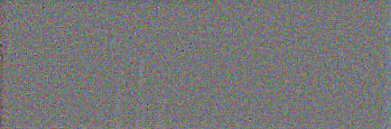
Noise Estimation
original
blurred w/ Gaussian σ=5
-
+
+
difference
Find the std. deviations of each band:
σ_{R} = 5.0981 σ_{G} = 4.0672
σ_{B} = 6.9212

Slide 66
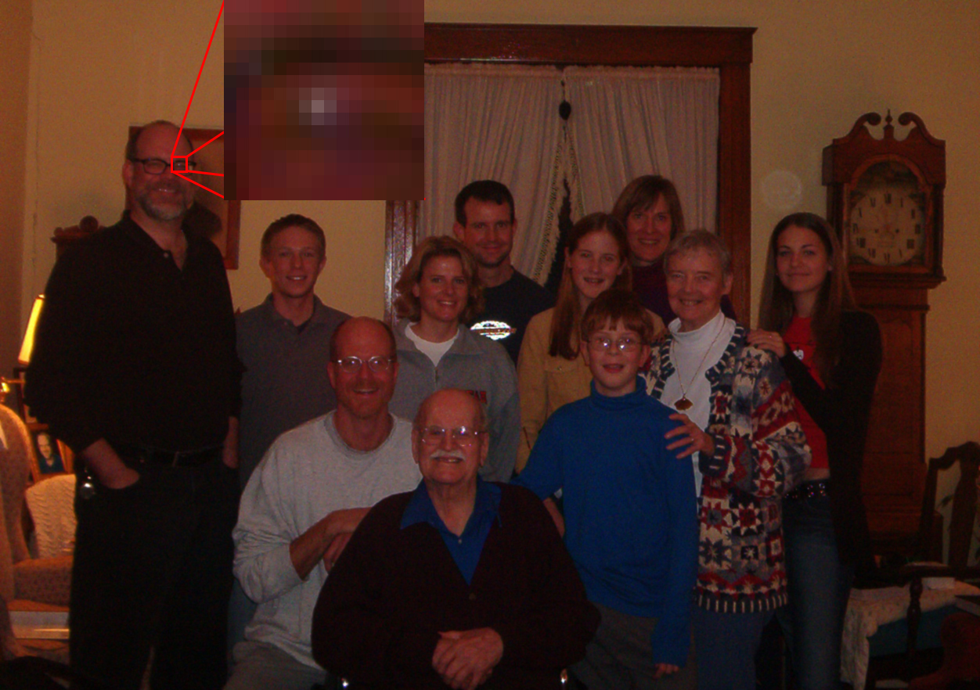
Pointspread Function Estimation
To estimate the PSF, find the image of a point and construct a convo-lution mask from it.

Slide 67


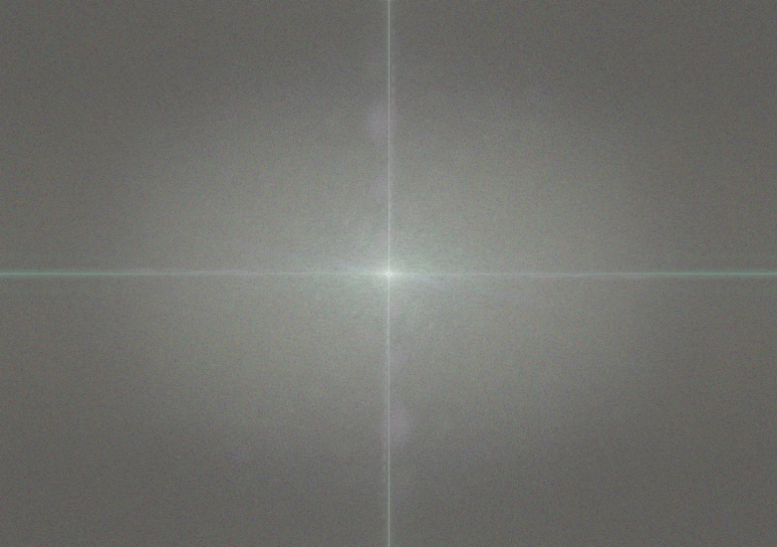

Wiener Filter Estimation

Slide 68
LMS Image Restoration (original)

Slide 69

LMS Image Restoration (filtered)

Slide 70
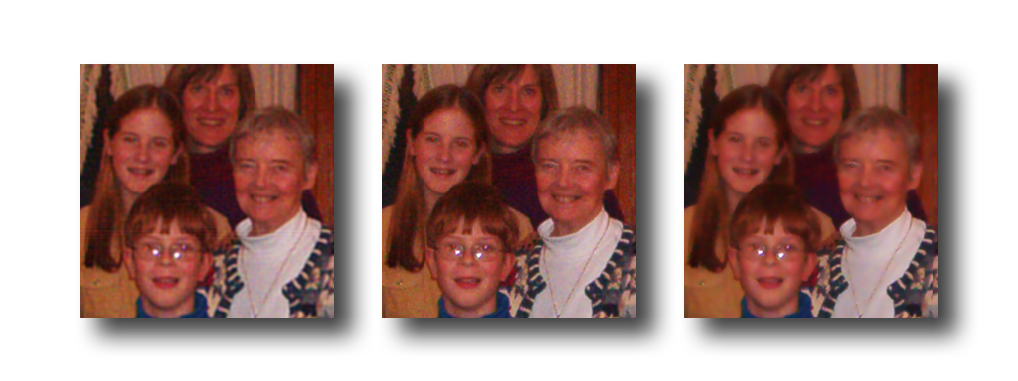
Detail of Results
The contrast of these has been increased to make the differences more visible.
original image
filtered image
matlab’s wiener2

